Slide 1
UNIVERSITY RANK PREDICTION
MELVIN NGURE
FINAL CDS PROJECT

Slide 2
INTRODUCTION
Universities are institution of higher learning providing facilities for teaching and research and authorized to grant various academic qualifications. It is thus important to choose one that would provide a student with the best chance of success.
Different metrics may be used to determine the best university for one to school at but generally, rank would be the best feature as it is derived from various characteristics.

Slide 3
RESEARCH QUESTIONS AND HYPOTHESIS
Research Questions
What factors constitute to ranking universities?
Which model would best suit ranking universities?
Hypothesis
Type of university, research output, student to faculty ratio, number of international student, size and faculty count all determine the rank of a university.
Which regression model would fit best : random forest regression, linear regression, decision tree regression ?

Slide 4
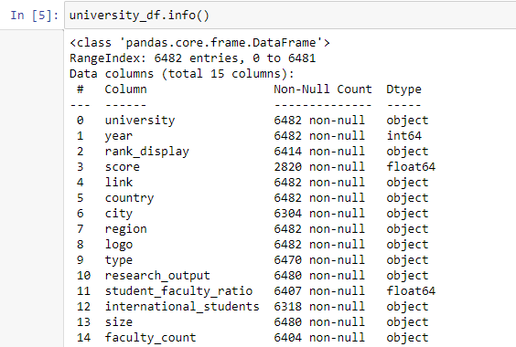
DESCRIPTIVE ANALYSIS
Target Variable - Rank
Independent Variables
Location of university
Type
Research output
Number of international students
Size
Student faculty ratio
Faculty count

Slide 5
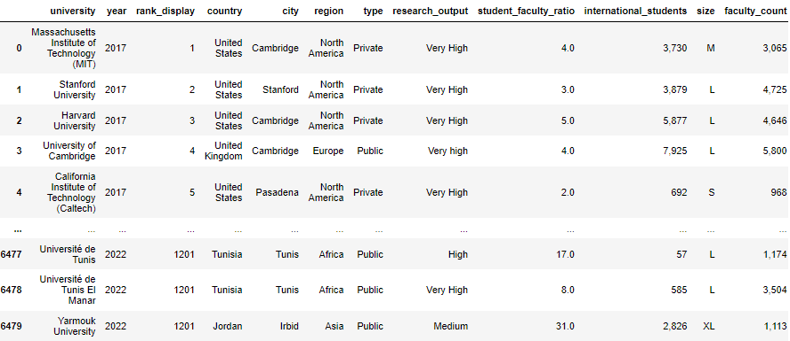
DATA PREPROCESSING
Data Cleaning
Checked for null values and dropped rows which had more than 5 null values.
Dropped logo and link columns since they are hyperlinks.

Slide 6
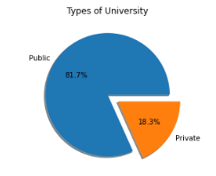
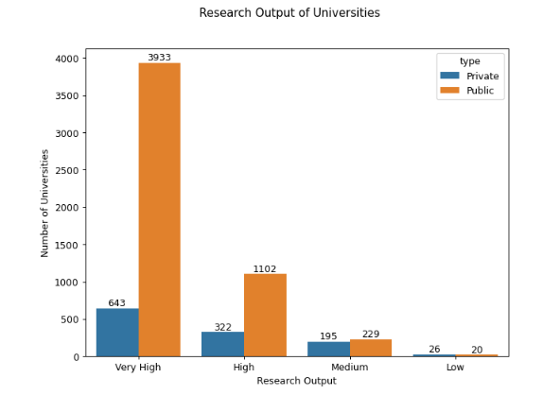
EXPLORATORY DATA ANALYSIS
Public schools are more common as compared to private ones
Public universities produce a significantly larger amount of research output as compared to public universities.

Slide 7
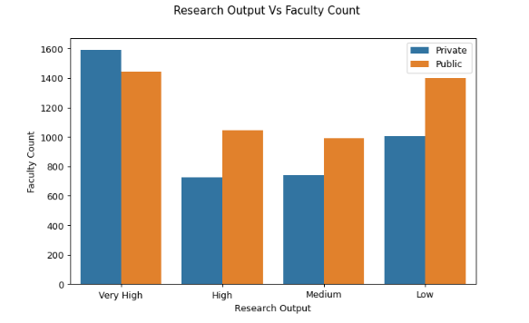
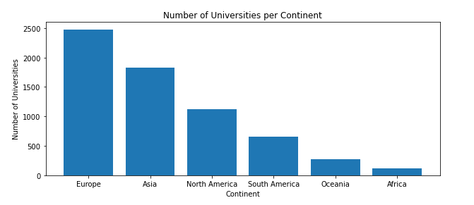
EXPLORATORY DATA ANALYSIS
Private universities with a large number of faculty produce more research output as compared to public universities.
Europe tends to be the continent with more number of universities

Slide 8
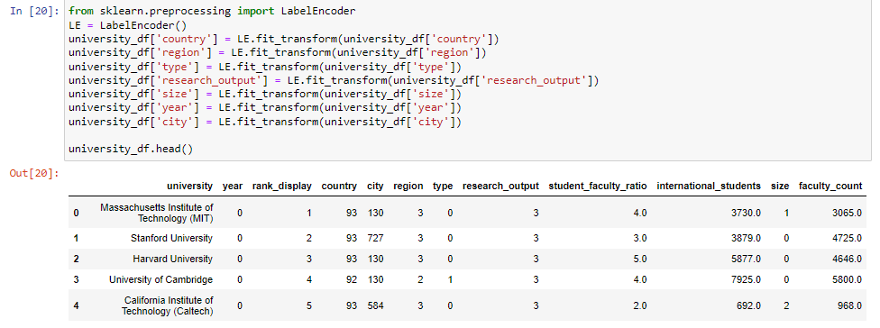
DATA ENCODING
Converted the labels(country, region, type, size, research output, year, city) into a numeral form so as to be in machine-readable form.

Slide 9
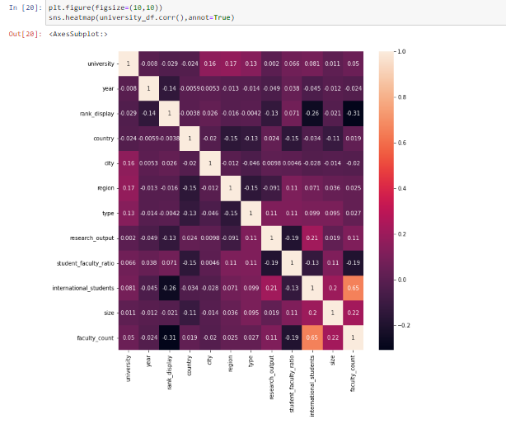
HEAT MAP
A heat map represents these coefficients to visualize the strength of correlation among variables.
The columns faculty count against number of international students are highly correlated thus hyper parameter tuning methods such as dimensionality reduction may need to be applied to improve on accuracy.

Slide 10
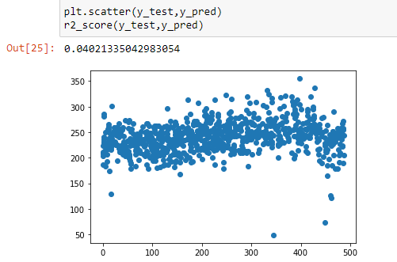
MODELLING
As noted previously, the task at hand would require a toimplementation of a regression model to obtain results for the assignment.
Linear Regression
This model happened to be the worst performing of the models with a r^2 score of 0.04.
This can be explained by the lack of linear correlation between the target and the various features.

Slide 11
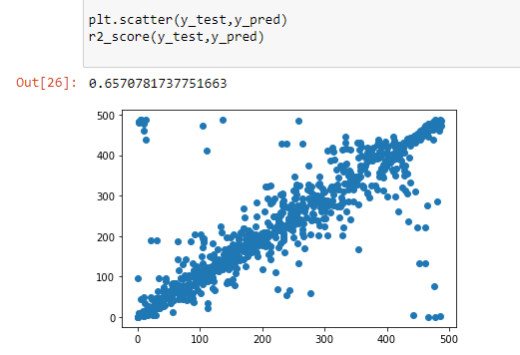
Decision Tree Regressor
This model performed way better than the previous one but not too well with a r^2 score of 0.68.
It breaks down a dataset into smaller and smaller subsets while at the same time an associated decision tree is incrementally developed, thus performs fairly well to the task at hand.

Slide 12
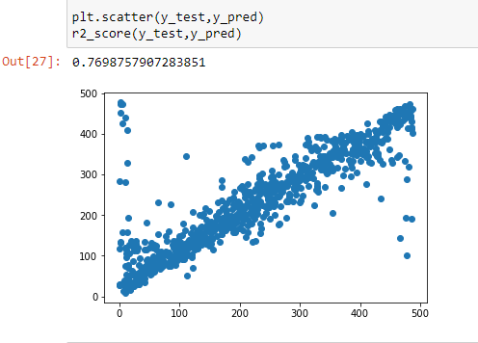
Random Forest Regressor
This model performed the best with a r^2 score of 0.77.
This can be attributed to the fact that random forests consist of multiple single trees each based on a random sample of the training data which greatly increases accuracy by averaging the various trees in the model.

Slide 13
FINDINGS
We set out to answer the following questions:
What factors constitute to ranking universities?
Which model would best suit ranking universities?
There is significant correlation only between number of international students and faculty count. Feature selection and dimensionality reduction would be useful in optimization of the best model.
While looking for a model, we found that the Random Forest Classification model worked best for us as it had an r^2 score of 0.77.
.

Slide 14
LIMITATIONS AND CONCLUSION
More significant data with high correlation would be important in increasing accuracy of the model. Hyper parameter tuning techniques such as feature extraction would be key.
In conclusion, we made use of a university ranking dataset from Kaggle to build a model which seeks to predict the ranking from various features to come up with a fairly well performing model with an r^2 score of 0.77.

Slide 15
REFERENCES
https://www.geeksforgeeks.org/python-decision-tree-regression-using-sklearn/
https://stackoverflow.com/questions/31323499/sklearn-error-valueerror-input-contains-nan-infinity-or-a-value-too-large-for
https://www.kaggle.com/code/rizqyad/qs-world-university-rankings-2017-2023

Slide 16
THANK YOU!
Any questions?

